Slide 1
Module 13

Slide 2

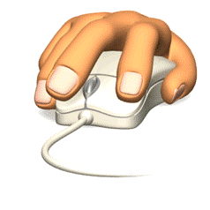
Synapse (2 – 20 nm)
and start a similar electrical impulse in the dendrites of next neuron
What happens in Muscles ?
These chemicals go across the small gap called as Synapse (2 to 20 nm) between the neurons
It sets off a chemical reactions producing an electrical impulse which travels from the dendrites to the cell body, through the axon to its end.
How neurons transmit messages from body to the brain ?
and are delivered to the muscle cells or glands.
The information from the environment is picked up by the specialized tips of dendrites.
When fingers touch the mouse.

Slide 3
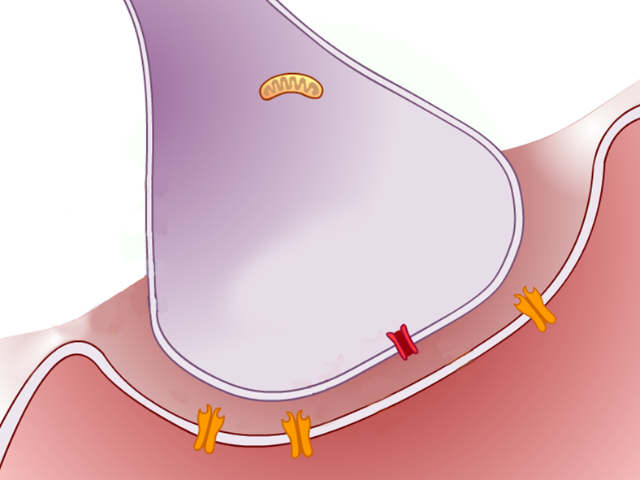
Chemicals are released in the muscle cells from nerve endings.
Muscle cells possess special kinds of proteins
They bring change in their shape and shortens the muscle.

Slide 4
Hence, the muscle shortens and click happens

Slide 5
Thank You

